Slide 1
Gas Laws
Student’s Name
Institutional Affiliation
Notes:
Hello everyone, I am going to make a presentation on Boyle’s Law, Charles Law, and Gay-Lussac’s Law where I will talk about their history, their formulas and their application in solving real-life problems. Hope you will enjoy. Welcome

Slide 2

Boyle’s Law
History
Developed by Robert Boyle in 1662
A build up of ideas by Richard Towneley and Henry Power
Holds that there occurs an inverse proportionality of pressure of an ideal gas and its volume (Kenny & Ponichtera, 2019).
The temperature remains a constant in Boyle’s law
Pressure of a gas tends to increase as its volume decreases
Notes:
Robert Boyle developed the gas law in 1662 and gave credit to existing ideas that were coined by two scientists; Richard and Henry who are said to have lived in the 17th century. The law hold s that there exists an indirect relationship between the pressure exhibited by a gas and its matching volume so long as its temperature remains unchanged.

Slide 3
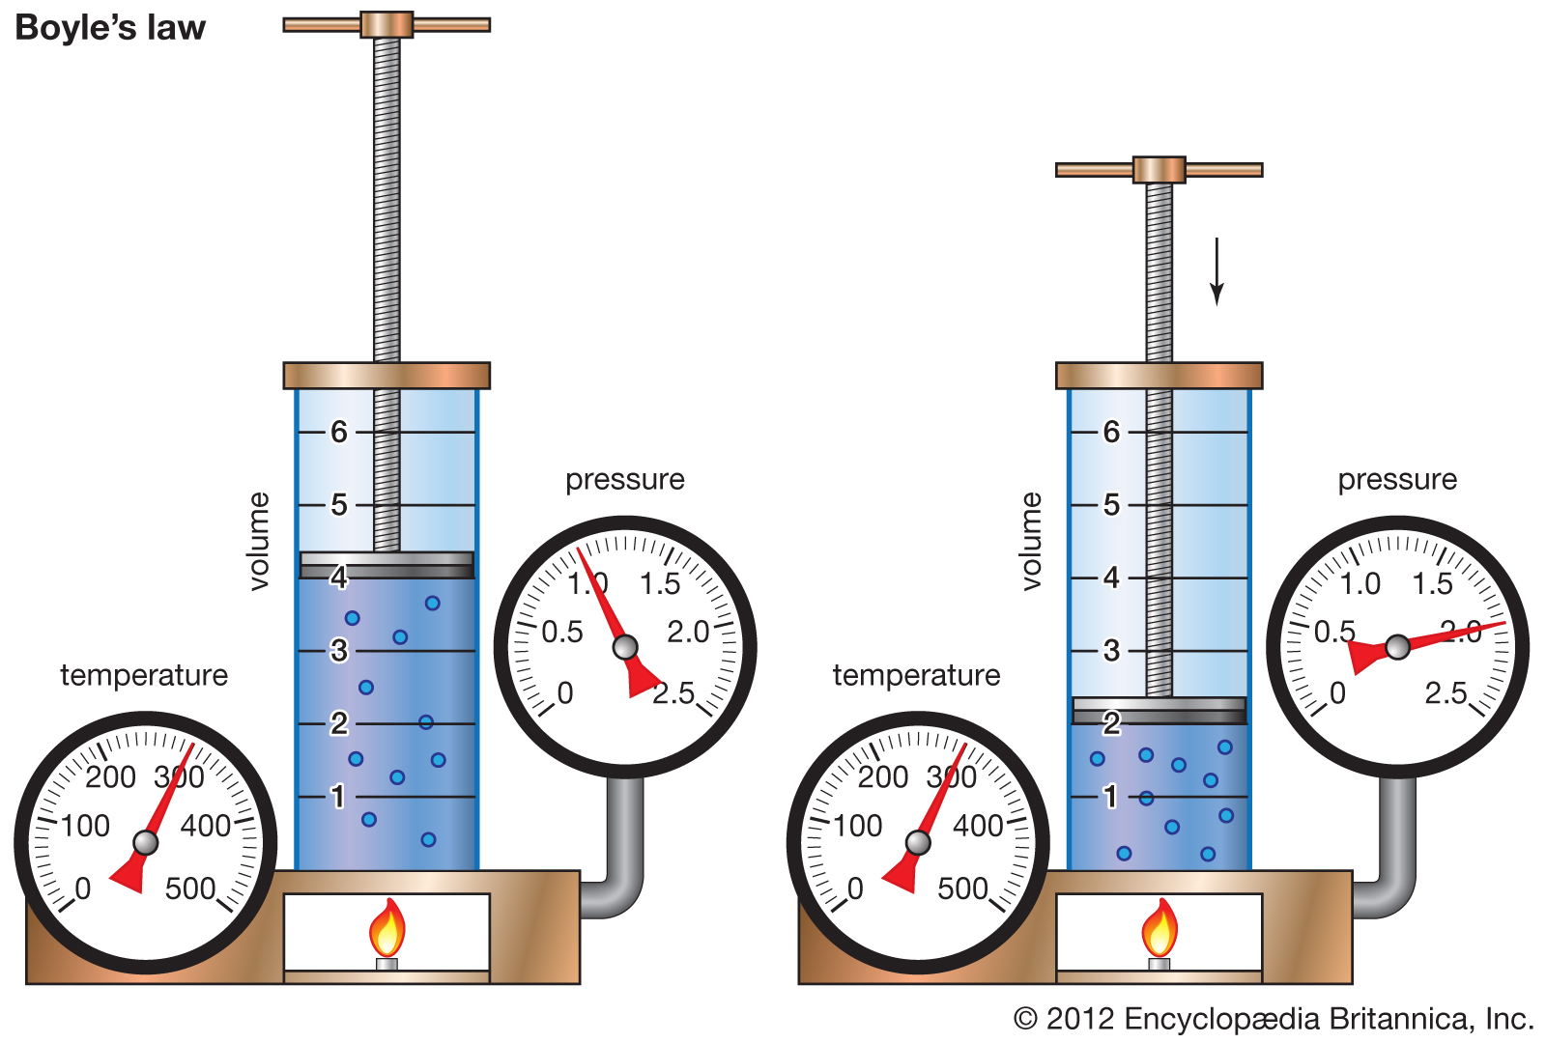
Boyle’s Law
Formula
PV=k
P₁V₁= P₂V₂
It implies that decrease in volume of a gas results in a decrease in overall pressure.
So long as the temperature of the system is a constant, the energy applied in the system remains unchanged.
Notes:
P stands for pressure and V stands for the volume and k- a constant that uniformly represents the volume and pressure. With the temperature being a constant, changing one parameter results in an indirect change of the other parameter.

Slide 4
Boyle’s Law
Example
With a gas at a temperature of 25.0⁰C with a volume of 3.60 liters and a pressure of 1.00 atm, calculate the volume at a pressure of 2.50 atm.
P₁V₁= P₂V₂
(1.00atm)(3.60 liters) = (2.50 atm)* X
X= (1*3.60)/2.50
X= 1.44L
Notes:
Substituting the values given in the formula P₁V₁= P₂V₂ and then solving for the unknown.

Slide 5
Gay-Lussac’s Law
History
Developed by Louis Gay-Lussac at the start of the 19th century
He utilized balloons filled hydrogen in his experiment
Gay-Lussac is well known for the Pressure that he was the first to discover
Holds that pressure of a gas with a specified mass exhibits a direct proportionality with its absolute temperature with the volume being held constant (Hadiningrum & Muldiani, 2018).
Notes:
The law was coined by Louis Gay-Lussac in 19th century during his experiments that he carried out using hydrogen-filled balloons. He is well known for the Pressure law he developed that holds that pressure of a gas that is enclosed is directly proportional to its temperature. For the law to apply, the volume is made to remain constant where the pressure of a gas increases in a direct proportionality with the temperature.

Slide 6
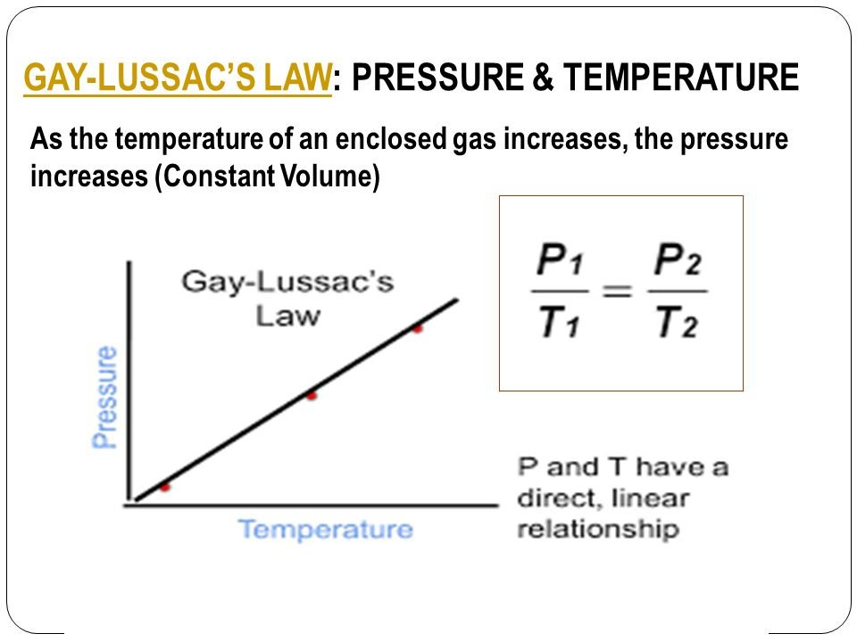
Gay-Lussac’s Law
Formula
P/T=k
P₁T₁=P₂T₂
P – Pressure, T – Temperature , k- Constant
The law happens to be a special case associated with ideal gas law
Cooling the gas at a constant volume makes the pressure to continue decreasing up to the point where the gas becomes a liquid
Notes:
Change of temperature possesses a direct proportionality in the change of pressure of a gas in cases where the volume remains unchanged.

Slide 7
Gay-Lussac’s Law
Example
Calculate the volume of a gas at 27⁰c in a case where its volume was 400 mL at 0⁰c.
0⁰C + 273= 273K
20⁰C + 273 = 300K
So
400mL*(300K/273K) = 439.G mL

Slide 8
Charles Law
History
Coined by Joseph Louis Gay-Lussac in 1802
Law was a build up of previous discovery by Jacques Charles back in 1780s
Jacques Charles had carried extensive studies on effects of temperature of the volume of a gas
Hold that volume of a gas has a direct proportionality to the existing temperature with volume being a constant (Limpanuparb et al., 2018)
Notes:
Joseph Louis Gay- Lussac develop Charles law in 1802 by building on the findings of Jacques Charles. The law holds that volume of a given gas tends to increase with increasing temperature in a system where the pressure is made a constant.

Slide 9
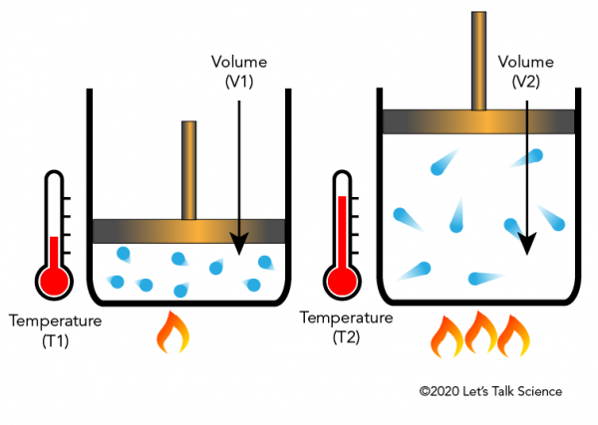
Charles Law
Formula
VἁT
V/T=k or V=kT
V- Volume , T- temperature, k- a non-zero constant
V_{I}T₂= V₂T₁
It is considered that at absolute zero, any gas has no energy and the molecules are resistant to any kind of motion

Slide 10
Charles Law
Example
Determine the decrease of temperature when 2.00L set 21.00c is subjected to compression to make it 1.00L
V_{I}T₂= V₂T₁
21+273= 294.0K
(2.00L/294.0K)= (1.00L)*X
2X= 294
X= 147.0K (-126⁰c) so the temperature decreases from 21⁰c to -126⁰c

Slide 11
References
Hadiningrum, K., & Muldiani, R. F. (2018). Optimization of the Amount of Gas Moles Determination through Boyle’s Law and Gay-Lussac’s Law Experiments. Journal of Physics: Theori and Applications, 2(2), 53-63.
Kenny, B. J., & Ponichtera, K. (2019). Physiology, Boyle's Law. StatPearls [Internet].
Limpanuparb, T., Kanithasevi, S., Lojanarungsiri, M., & Pakwilaikiat, P. (2018). Teaching Boyle’s law and Charles’ law through experiments that use novel, inexpensive equipment yielding accurate results. Journal of Chemical Education, 96(1), 169-174.

